Slide 1
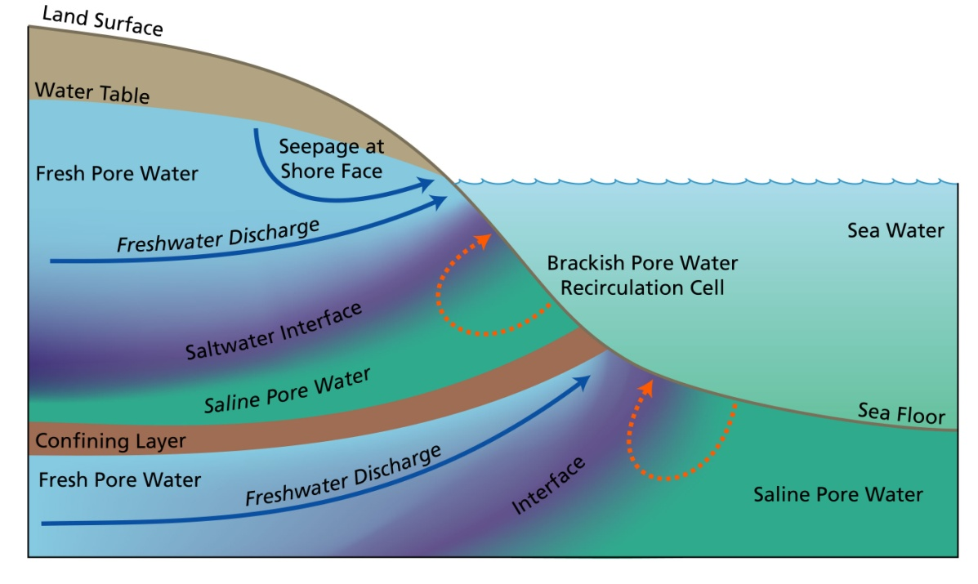



Measuring fluxes of Mo, U and Re in Ocean Island Submarine Groundwater Discharge
42 Mo
92
U
75
Re
Joseph Murray
Arizona State University
Advisors: Ariel Anbar – ASU
Matt Charette - WHOI

Slide 2
Goals
Investigate the trace metal geochemistry of SGD on ocean islands
  Molybdenum, Uranium and Rhenium
  These metals have similar chemistry and redox sensitivity, and are used as important proxies for paleo-redox conditions
Begin to constrain possible fluxes and isotopic compositions of these elements from ocean island submarine groundwater discharge (SGD)
  SGD can be a source or a sink for elements, depending on the condtitions
  Contribute to a better understanding of the global element budgets for these elements
Relate coastal hydrogeology to SGD chemistry and fluxes in order to better understand how ocean island SGD fits into global trace metal budgets
  This has important implications for the use of these metals as paleo-proxies
Notes:
Say why these metals: similar chemistries –redox sensitivity
in a broad sense they behave similarly
SGD has been shown to be important sources or sink of U in previous studies, so this work is motivated by a desire to see if Mo and Re behave similarly or differently that U

Slide 3
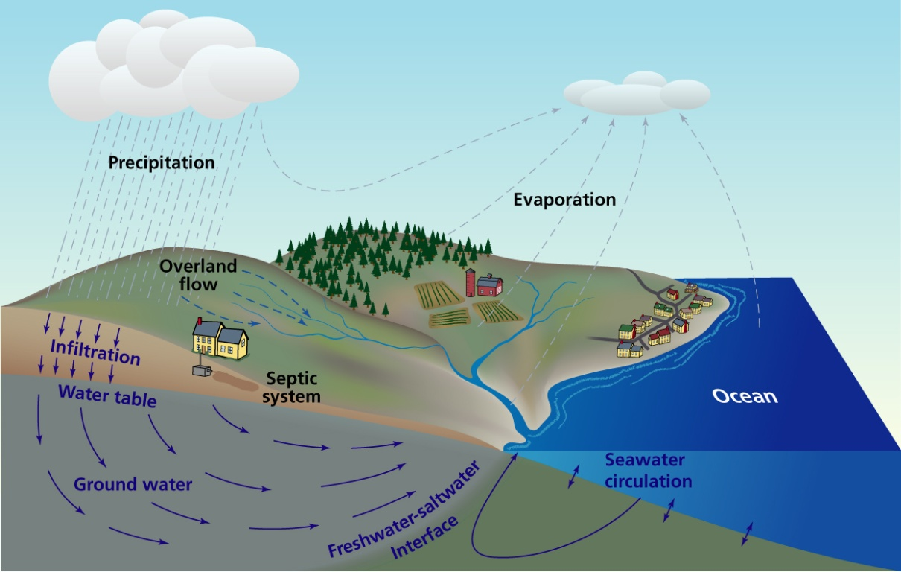
Submarine Groundwater Discharge
Flow of fresh groundwater or re-circulated seawater from coastal aquifers into the coastal ocean.
Once neglected due to the fact that it was difficult to measure
New geochemical tracers such as radon and radium can now be used to accurately quantify SGD fluxes
SGD may be an important source of dissolved elements to the coastal zone.
(Image: Jack Cook, WHOI)
Notes:
Even though volumetric fluxes of SGD are not all that high, the solute fluxes can be orders of magnitude higher than those in rivers, sometimes putting SGD solute fluxes on par with riverine solute fluxes.

Slide 4
SGD on Ocean Islands
 | Estimated SGD Flux
Global Freshwater Total (6-7% of total river flux) | 2400 km³/yr
Continents | 1500 km³/yr
Oceanic Islands | 900 km³/yr
Around 38% of global SGD may come from oceanic islands - Why?
Many located in humid, tropical regions, and therefore receive high amounts of rainfall
Consist largely of fractured volcanic bedrock and permeable carbonate sediments
Poorly developed river systems
(Zektser, 2000)
Notes:
Study of ocean island SGD may reveal much about the role SGD plays in global oceanic element budgets

Slide 5
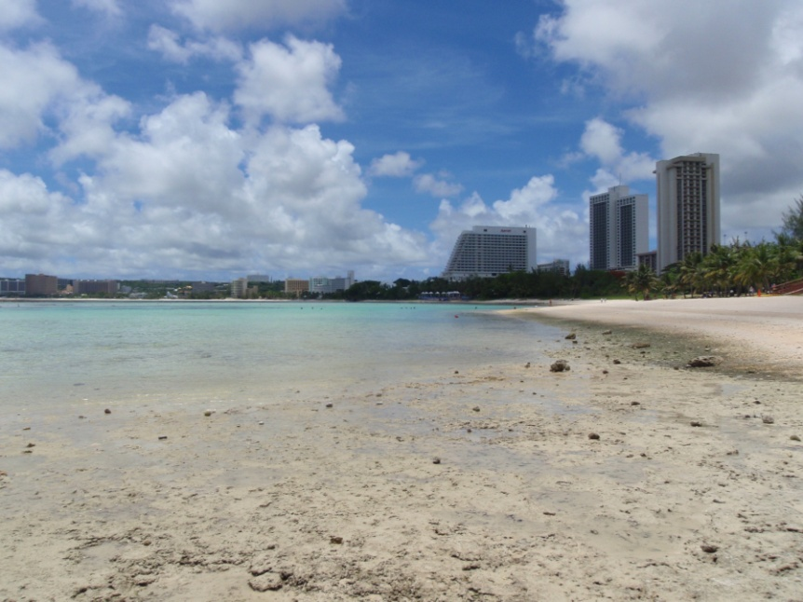
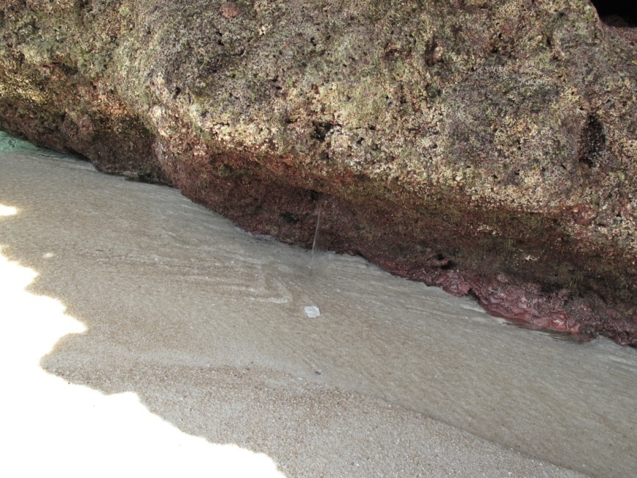
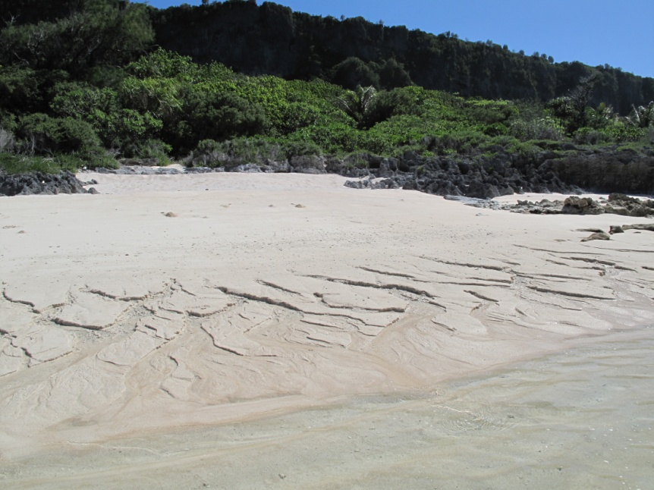
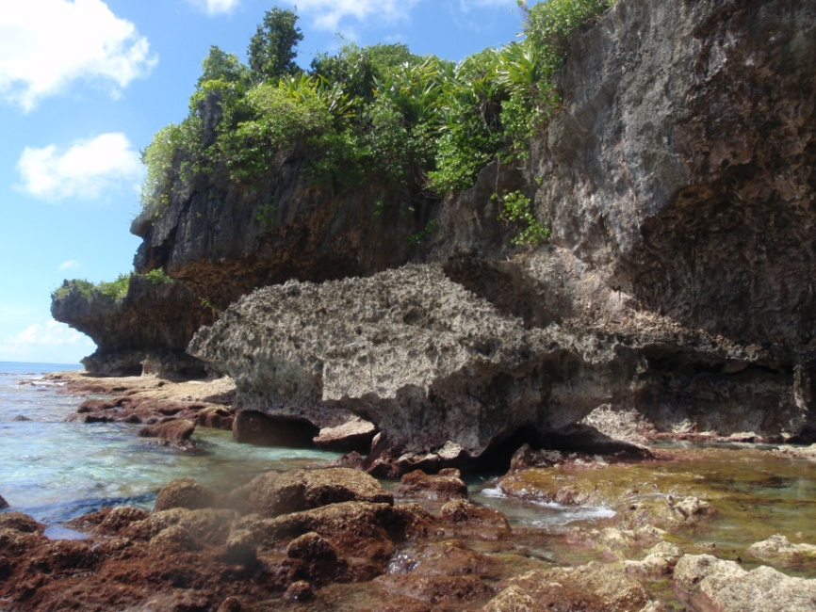
SGD on Guam
Notes:
Tumon Bay 2. Spring from a rock on Northern Guam coast
3. Typical seep feature 4.Cave spring emptying out directly into the sea
as the tide goes out

Slide 6
Methods
Elements of interest are present at very low levels (nM-pM)
Requires a chemical separation method to purify and concentrate the trace metals
Ion chromatography is typically used: two published methods were tested
  Pearce et al., 2009: Single pass anion exchange column
  Malinovsky et al., 2005: Chelating ion exchange column using Chelex resin
Concentrations are measured using ICP-MS

Slide 7
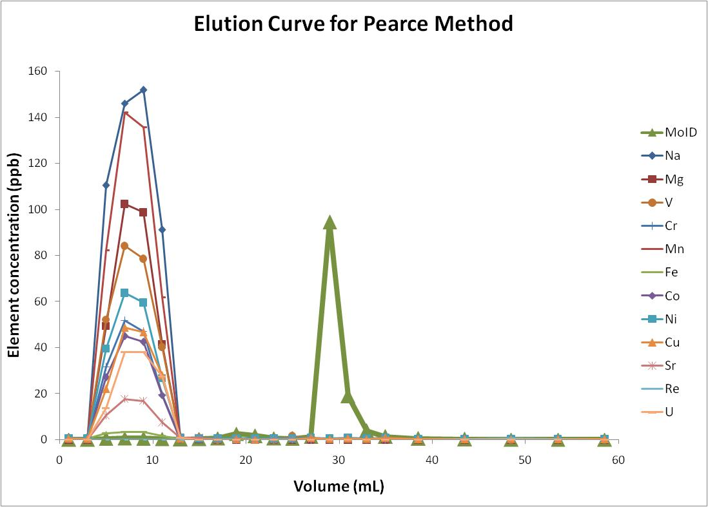
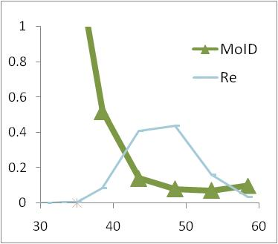
Advantages:
Excellent separation of interferences
Clean, quantitative recovery of Mo, Re
Quick and easy to use: can be used on large numbers of samples
Disadvantages:
Uses large amounts of HF
Uranium is eluted with salt matrix
  We think we know how to solve this problem
Notes:
Introduce what you did: e.g. elution curves – DESCRIBE FIGURE
Separation from Fe is crucial, and this method does this very well
Quantitative recovery is important if we want to measure the isotopic composition
Uranium elution characteristics are sensitive to concentration of HF used.
Manipulate concentration of HF used to elute U cleanly first
Currently testing this

Slide 8
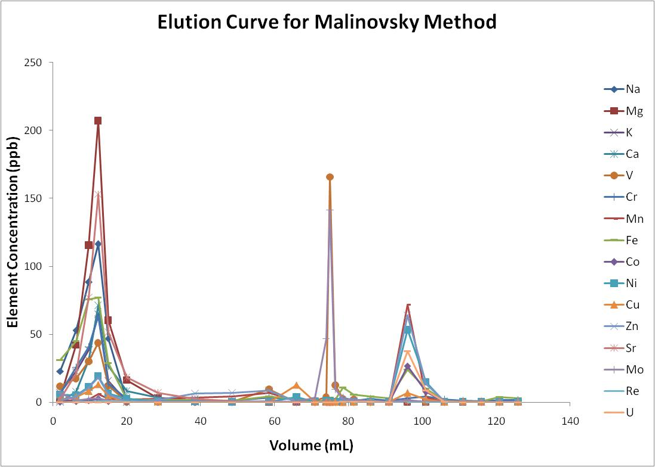
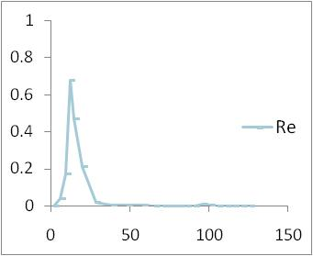
Disadvantages:
Less than quantitative yields
Incomplete separation
Larger column volume
  130 mL vs. 60 mL
Much longer process
  Less samples/day
Higher blanks
Use of ammonia
Notes:
As you can see I did not put up an “Advantages” section, because as far as we can tell, the Pearce method is better in nearly every way for our purposes

Slide 9
Future work
  Finish small changes to Pearce method and start measuring samples from Guam
  Calculate local element fluxes to the ocean
  Compare measurements to those made for mainland SGD sources (Massachusetts, Mexico)
What we hope to learn
  How coastal geology effects the chemistry of SGD
  The impacts SGD has on trace metal concentrations and isotopic composition of seawater

Slide 10
Acknowledgements
Steve Romaniello
Gwyneth Gordon
Matt Charette
Crystal Breier
Meagan Gonneea
Paul Henderson

